Slide 1
New way to design the end-barrier in Circular geometry, with dx parameter
August 30 2016
simone.ferrari@polito.it

Slide 2
Content
Old way to design end-barrier without dx parameter
New way to design end-barrier with dx parameter
Comparison of the 2 method

Slide 3
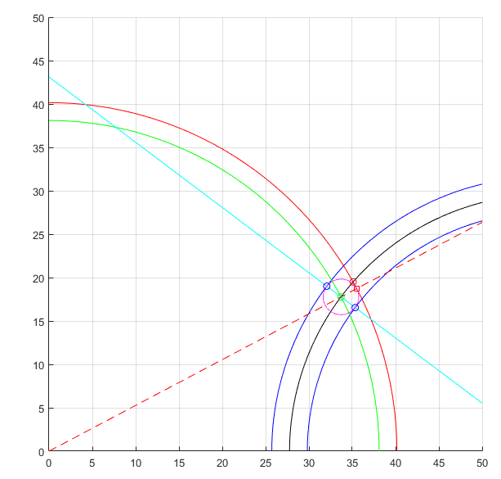
Old way to design end-barrier without dx parameter
Find (xc,yc) (green dot) intersecting the axis of the barrier (black) and the circumference centered in (0,0) and with a radius of (r-pont0-hc/2) (green)
Find the end-points of the barrier intersecting the circumference certered in (xc,yc) and with a radius of hc/2 (magenta) and the line for (x0,0) and (xc,yc) (cyan)

Slide 4
Old way to design end-barrier without dx parameter
The red dot is the location if the tangential ribs defined by alpha_pu
The red square is the effective point of the ribs
The end-barrier is an arc with center (xc,yc) and radius hc/2 (half of magenta circumference)

Slide 5
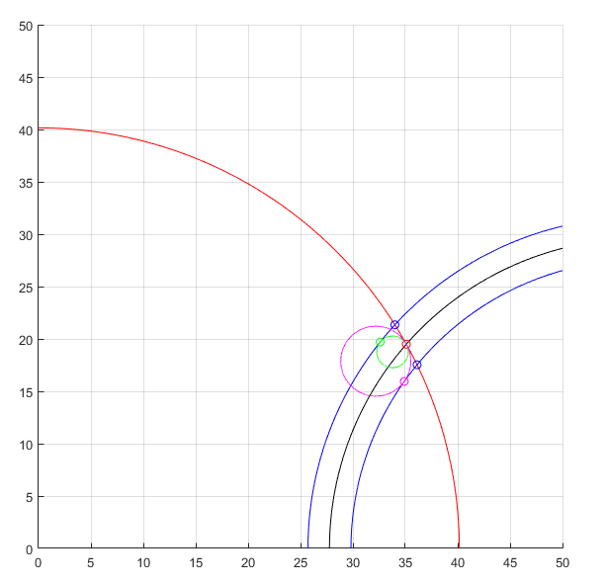
New way to design end-barrier with dx parameter
The end-barrier is designed with 2 arcs, like Seg geometry
The arcs (green and magenta) is obtained searching the circumference tangential to the red circumference ((0,0) radius=r-pont0) and the sides of the barrier (blue center=(x0,0) radius=x0-Bnk) and passing through (xpont,ypont) (red dot)

Slide 6
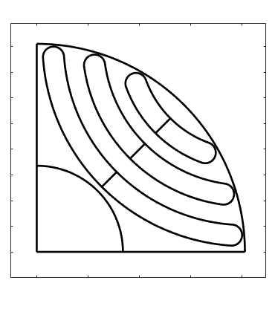
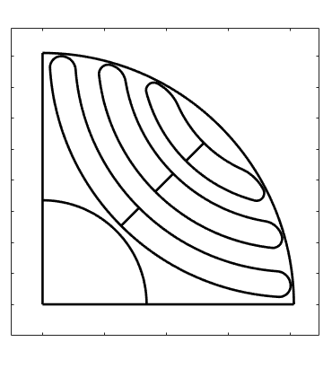
Comparison between the old method and the new method
OLD DESIGN
NEW DESIGN

